Slide 1
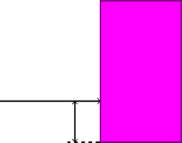
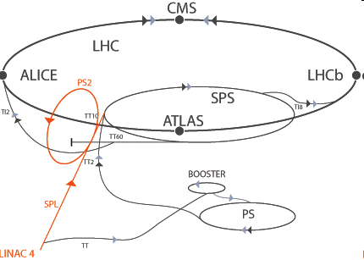



Collimation in the CERN PS Booster Penny Jackson: p.jackson1@physics.ox.ac.uk John Adams Institute/University of Oxford/CERN
This is a feasibility study into a collimation system for the CERN PS Booster (PSB) for the first stage of the LHC luminosity upgrade. A new machine, LINAC4, will be feeding the PSB in a few years and the difference in performance from the current LINAC2 could lead to severe radioactivity problems if the beam halo is not prevented.
Introduction & Design
The PSB (Proton Synchrotron Booster) is the first synchrotron in the chain of accelerators ending in the LHC. Currently, LINAC2 (a lower energy linear accelerator) provides protons to it and this will soon be replaced by the higher energy and higher current LINAC4. Stray particles will potentially cause more activation (radioactivity from stray particles) because of the higher injection energy and more of them, this is balanced to some extent by the higher energy beam having a lower emittance (smaller size) so a smaller fraction of the beam particles will hit the beampipe in the first place.
The collimator described in this poster is a two-stage system, the first a thin scraper to deflect the outermost beam particles and the second a thicker absorber to remove these deflected particles. The variables investigated for the scraper were material, thickness and shape, and the absorber variables were the aperture’s x and y size.
Right: Diagram explaining the impact parameter (d), the perpendicular distance from the absorber aperture. A large impact parameter is good because it means the particle is more likely to be absorbed. For small or zero impact parameters the particle is likely to be scattered back out, which can make it even more likely
d
to hit the beampipe.
Sample result
Below: The efficiency is the fraction of particles hitting the absorber out of all particles removed from the simulation (the rest hitting the beampipe). This is an example showing the x plane for a wedge shaped scraper, giving very good results for aluminium and carbon.
Left: A diagram of how the collimator should work (not to scale). The yellow arrows show the path and direction of the beam.
Conclusions
A scraper with an aperture of 33x18mm made from aluminium or carbon and an absorber with an aperture of 36x21mm gives a high efficiency and multiple turns before absorption, and room for error in construction. Wedges up to about 1mm thick work for either, as does constant thickness carbon of about 0.1mm. Flat sheets are thicker at the aperture and therefore less prone to damage from the beam.
Above: the two scraper designs tried here. On the left is one with wedge-shaped cross section, making it very thin near the central aperture. On the right the collimator is of constant thickness throughout. Thicknesses quoted for wedge-shaped scrapers are for the widest point (the other edge), 100mm from the aperture. Thinner scrapers are preferred because the particle is more likely to make many passes through them before being absorbed, and this will increase the impact parameter. However, thin scrapers are harder to construct and are more likely to become damaged by the beam itself.
Right: CERN accelerator complex for the LHC upgrade, LINAC4 first.
References
Christian Carli, private communication
All simulations done in Wolfram Mathematica

